Slide 1

LIVE EVENT DETECTION FOR PUBLIC SAFETY
GUIDE : Dr. Blessy Queen Mary M
TEAM MEMBERS :
Guruswathi B – 71772118111
Muthumaha S – 71772118129
Shunmuga Priya R – 71772118140
Tamil Selvi A - 71772118149
Notes:
1

Slide 2

PROBLEM STATEMENT
Threat to Society :
Humans pose a significant threat to society through criminal
activities such as robbery, assault, and homicide. These situations
are particularly dangerous for individuals working alone at night in
remote areas, especially women.
Lack of Effective Solutions :
Existing safety measures often lack accuracy and suffer from delays
in threat prediction, making them inefficient in preventing or
mitigating these dangers.
Notes:
1

Slide 3
OBJECTIVE :
Develop a software-based threat detection system using audio signals.
Achieve a minimum accuracy of 94% in threat detection and classification.
Design a real time alert system to notify registered contacts in emergency situations.
Ensure the system is hardware independent and can operate on various devices.
Notes:
1

Slide 4
EXISTING SYSTEM
Hardware-Based Approach :
A previous research project developed a hardware based system that included a camera, sound sensor, GPS, and GSM module.
This system relied on a wearable device to detect screams and send alerts to emergency services.
Notes:
1

Slide 5
CHALLENGES AND ISSUES IN EXISTING SYSTEM:
Bulky and Inconvenient:
The hardware-based system was physically large and required users to wear it constantly, making it uncomfortable and impractical for regular, everyday use.
2. Limited Scalability:
The reliance on physical hardware components meant that it was difficult to expand or scale the system, restricting its potential to be adapted for different or larger applications.
3. Accessibility Issues:
Because of its dependency on hardware, the system was less accessible to a wider audience, as it couldn't easily be distributed or used by people without access to the necessary equipment.
Notes:
1

Slide 6
PROPOSED SYSTEM:
1.Audio Signal Acquisition :
The system utilizes the default microphone configuration of a smartphone to acquire live audio signals from the victim's surroundings.
2 Audio Analysis and Classification :
The acquired audio signals are analyzed and classified using deep learning models, specifically LSTM,1D-CNN, and 2D-CNN, to identify potentially dangerous events.
3 Alert Notification :
Upon detection of a dangerous event, the system automatically sends alert messages to the victim's registered contacts via email, SMS, and WhatsApp, including the recorded audio as evidence.
Notes:
1

Slide 7
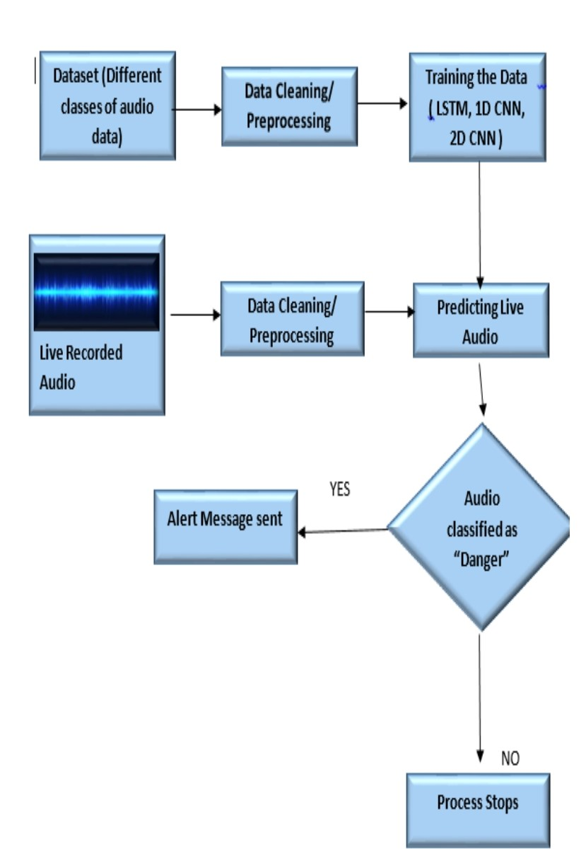
FLOW DIAGRAM
Notes:
<number>

Slide 8
MODULE DESCRIPTION:
1.Preprocessing:
MFCC Feature Extraction: Extracted MFCC features from audio files using `librosa`, dynamically adjusting parameters to capture key sound characteristics. Dataset Preparation: Split data into features (MFCCs) and labels (classID), with one-hot encoding for classification tasks. Data Splitting: Used `train_test_split` to divide data into 80% training and 20% testing sets for model evaluation. Data Reshaping for Models: - Reshaped data for 1D CNN (temporal features) and 2D CNN (time-frequency features), ensuring compatibility with neural networks.

Slide 9
2.Audio Recording Module :
Audio Capture
*Smartphone's microphone records ambient sound in real-time
*Audio is captured in small frames for immediate processing
*Sampling rate and bit depth determine audio quality
Noise Reduction
*Removes background noise (e.g., wind, static)
*Enhances clarity of the main audio signal
Normalization
*Adjusts audio volume to a consistent level
*Prevents quiet or overly loud sounds
*Ensures uniform audio quality for further processing

Slide 10
3.Audio Analysis Module :
Deep Learning-based Audio Analysis
Utilizes preprocessed audio signals for analysis
Applies deep learning models (e.g., CNN, LSTM) to extract features
Sound Event Classification- Classifies audio into predefined categories
Categories include everyday sounds and potential threats (e.g., alarms, screams)
Threat Detection
Identifies suspicious or dangerous sound patterns
Triggers alerts for real-time response based on detected threats

Slide 11
4.Alert Notification Module :
Automatic Alert Generation
*Sends alerts to the victim's registered contacts automatically
*Alerts are triggered by the detection of a potential threat
Multi-channel Communication
*Delivers notifications via Email, SMS, and WhatsApp
*Ensures timely and reliable communication across multiple platforms
Threat Information and Recorded Audio
*Alert messages include details of the detected threat
*Provides the recorded audio as evidence or context

Slide 12
LITERATURE REVIEW:
S. No | Paper Title | Year of Publish | Author | Algorithm | Merits | Demerits
1. | Urban Noise Recognition with Convolutional Neural Network | 2019 | Jiuwen Cao, Min Cao, Jianzhong Wang | CNN | *Better Time-Frequency Representation *No Need for DCT *Human Perception-Based | *High Dimensionality *Sensitive to Noise *Data-Intensive
2. | Improving smart cities safety using sound events detection based on deep neural networks | 2020 | Giuseppe Ciaburro,Gino lannace | CNN | *Effectively detects UAV *Enhance smart city surveillance and security | *Limited to UAV detection *Struggle in extremely noisy environments
3. | Sentimental Analysis in Non-Fixed length audios | 2021 | Maria Teresa ,Oscar Garcia,Carmen benavides | FNN | *flexibility in handling *High accurancy and aplicability | *potential challenges in processing multilingual data
4. | An Interopable Deep learning Model for Automatic Soun dclasssification | 2021 | Pablo Zinemanas | SB-CNN | *Interoperability *Automatic Network refinement | *Higher Complexity *Smaller benchmark

Slide 13
LITERATURE REVIEW:
S. No | Paper Title | Year of Publish | Author | Algorithm | Merits | Demerits
5. | Deep learning Based source identification of environmental audio | 2023 | Krishna presannakumar | LTF-CNN | *Deep learning Framework *Focus on environmental Sound classsification | *Single method focus *No-Real-Time Implementation
6. | A novel image and audio based artificial intelligence service for security applications in autonomous vehicles | 2021 | Dimitrios Tsiktsiris,Anastasios Vafeiaadis | CNN, Bidirectional LSTM | *Real time detection system *Using both audio and visual data | *Focus only on security inside vehicles *Performance may degrade in poor lighting
7. | Sound Classification Based on Multihead Attention and Support Vector Machine | 2021 | Lei Yang , Hongdong Zhao | SVM | *Parallel Processing *High Generalization | *Complexity *Limited Scalability to Large Datasets
8. | Implementation of IOT based real time women safety system | 2024 | Praveen Bleessington thummalakunta | Hardware based | *Compact size Built in sensor Loe power consumption | *cost *limited I/O pins *memory constrains

Slide 14
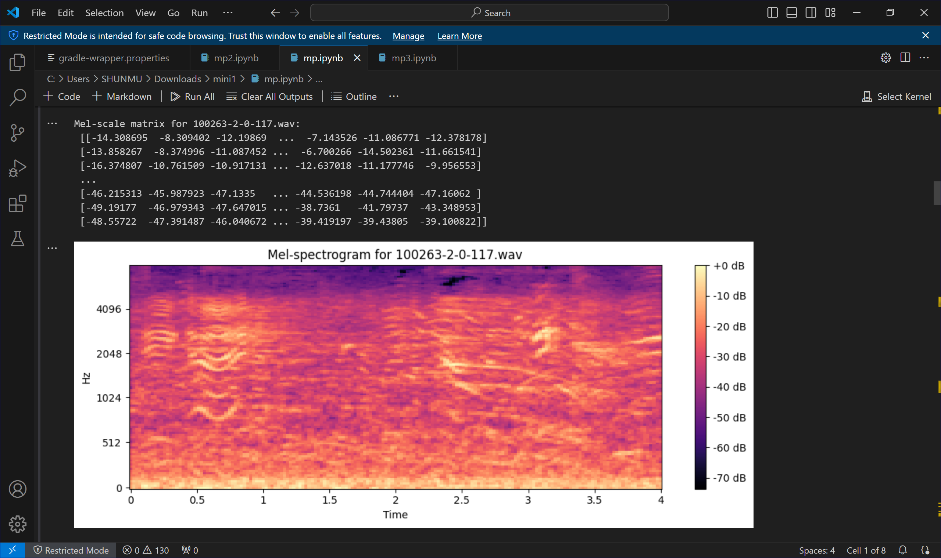
PROJECT STATUS:
Visualizing the MFCC Features:

Slide 15
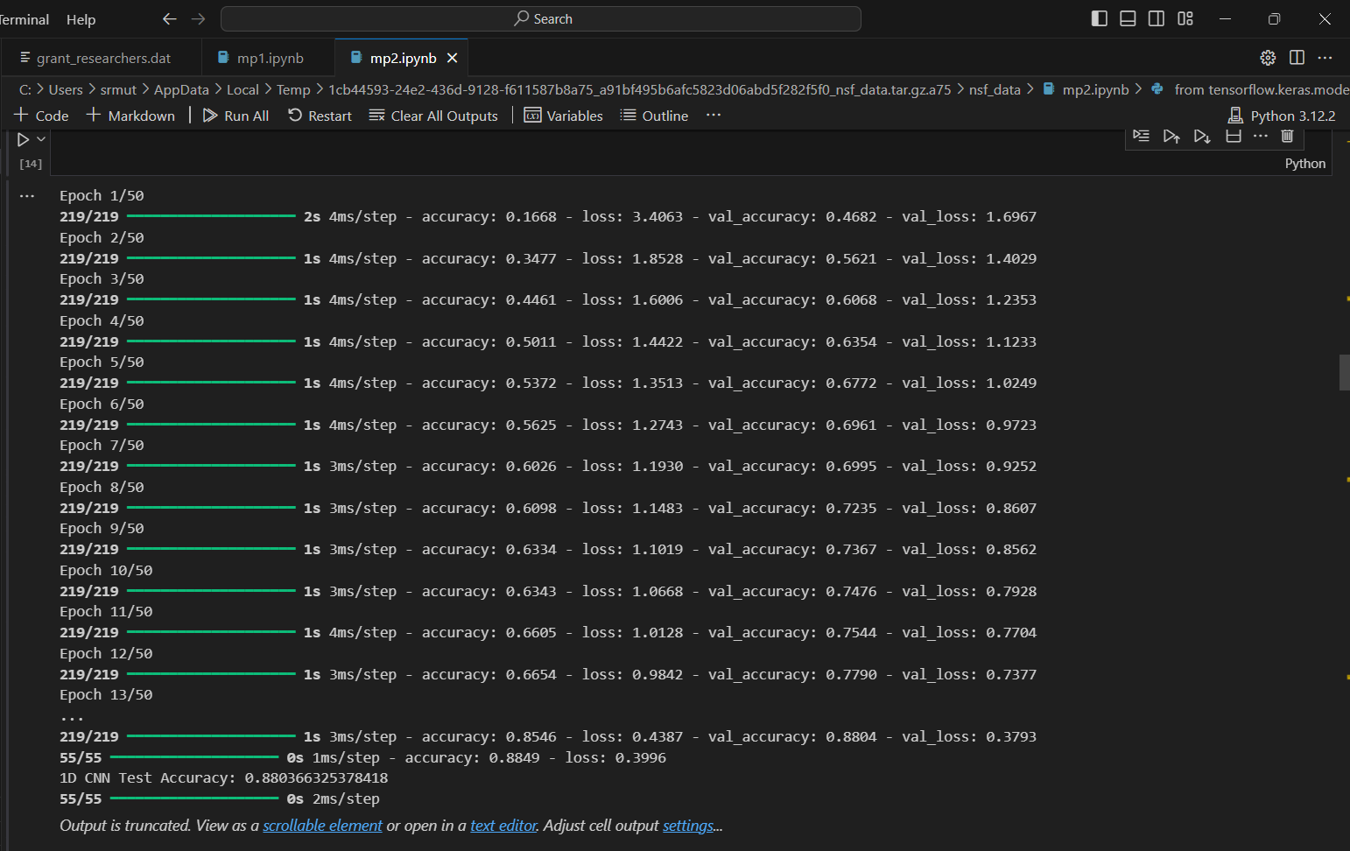
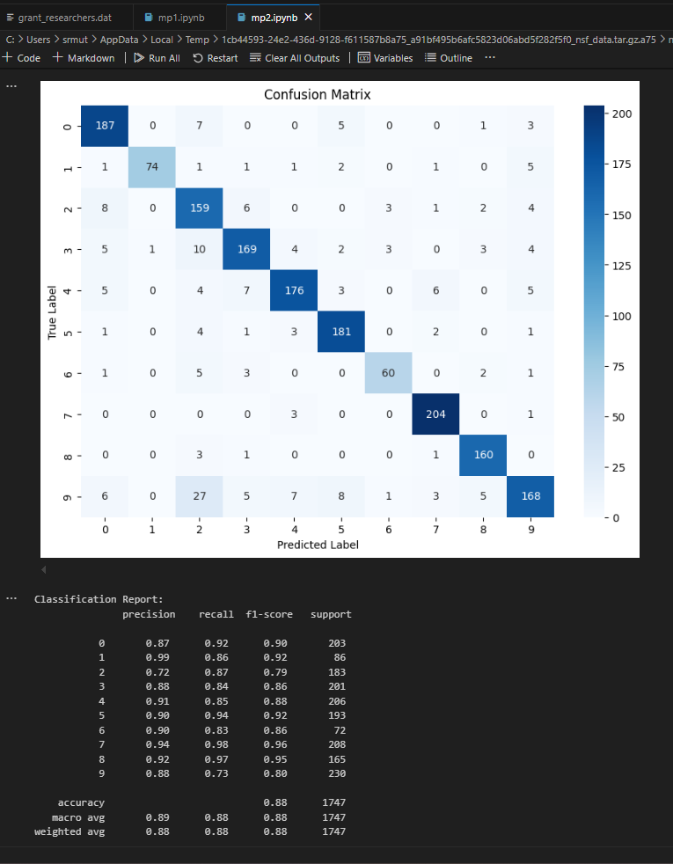
1D CNN :
Accuracy:
Confusion Matrix:

Slide 16
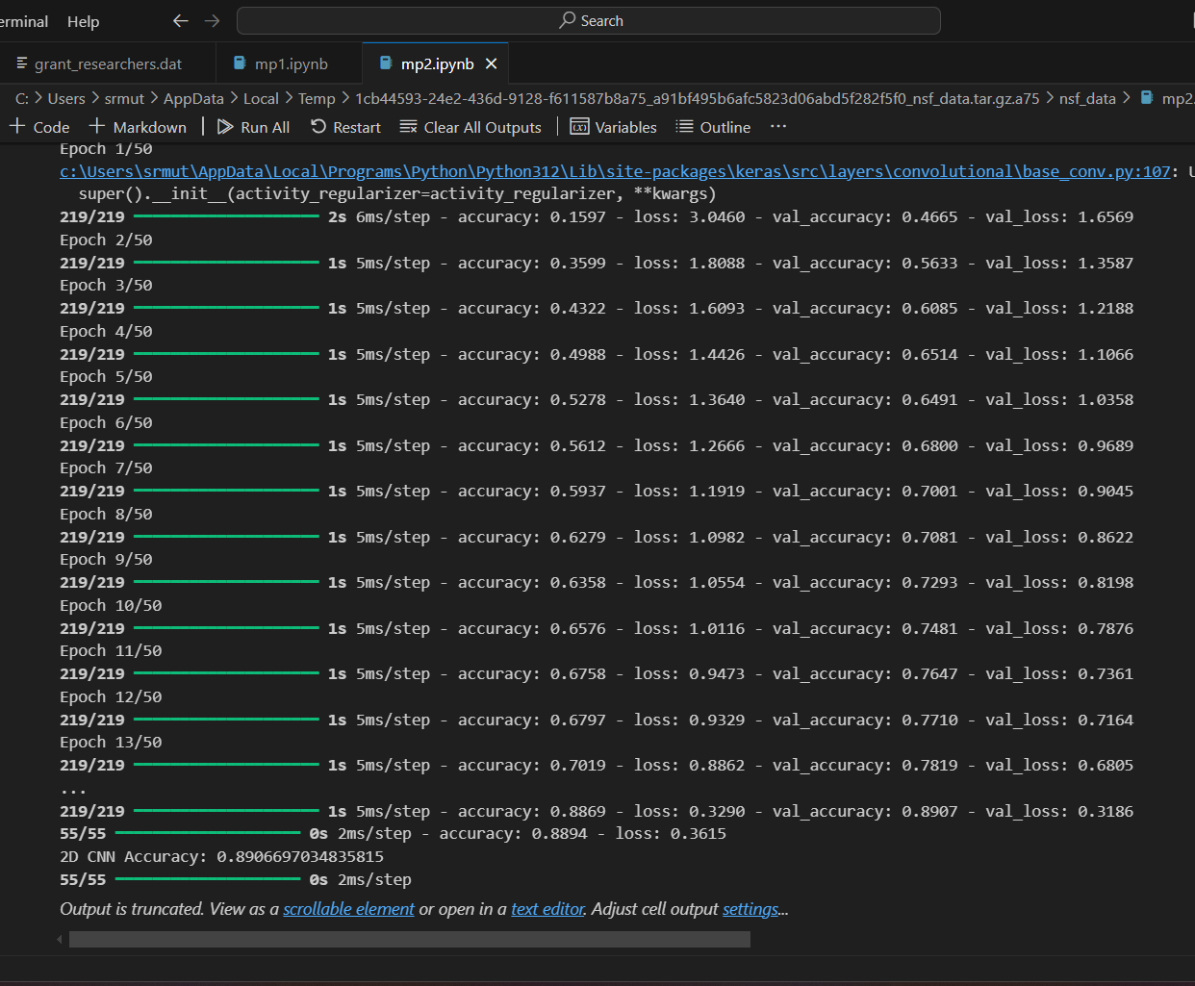
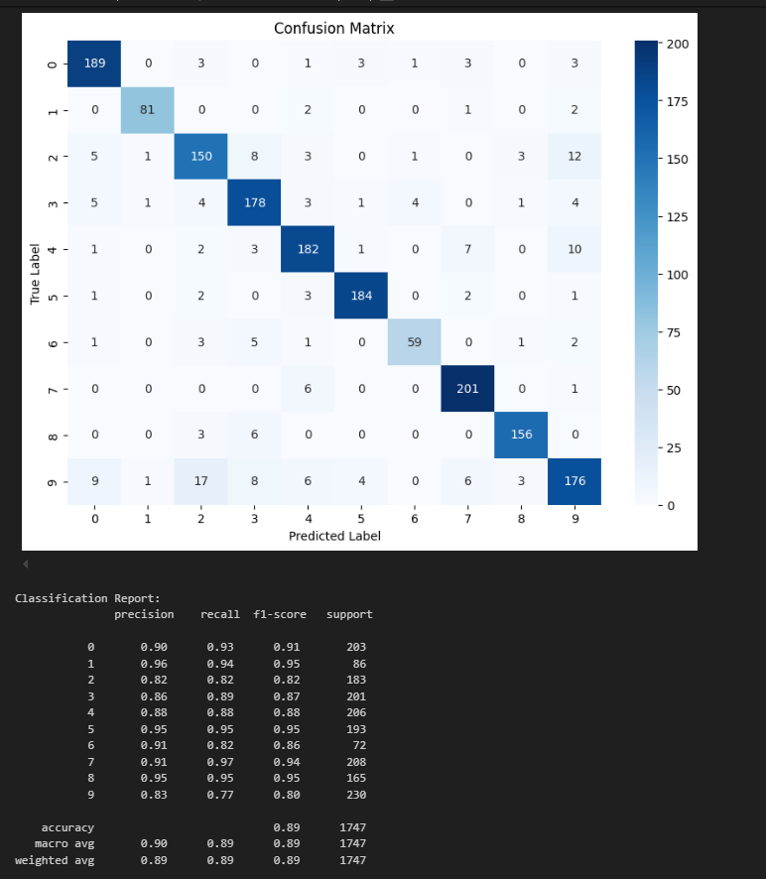
2D CNN :
Accuracy:
Confusion Matrix:

Slide 17
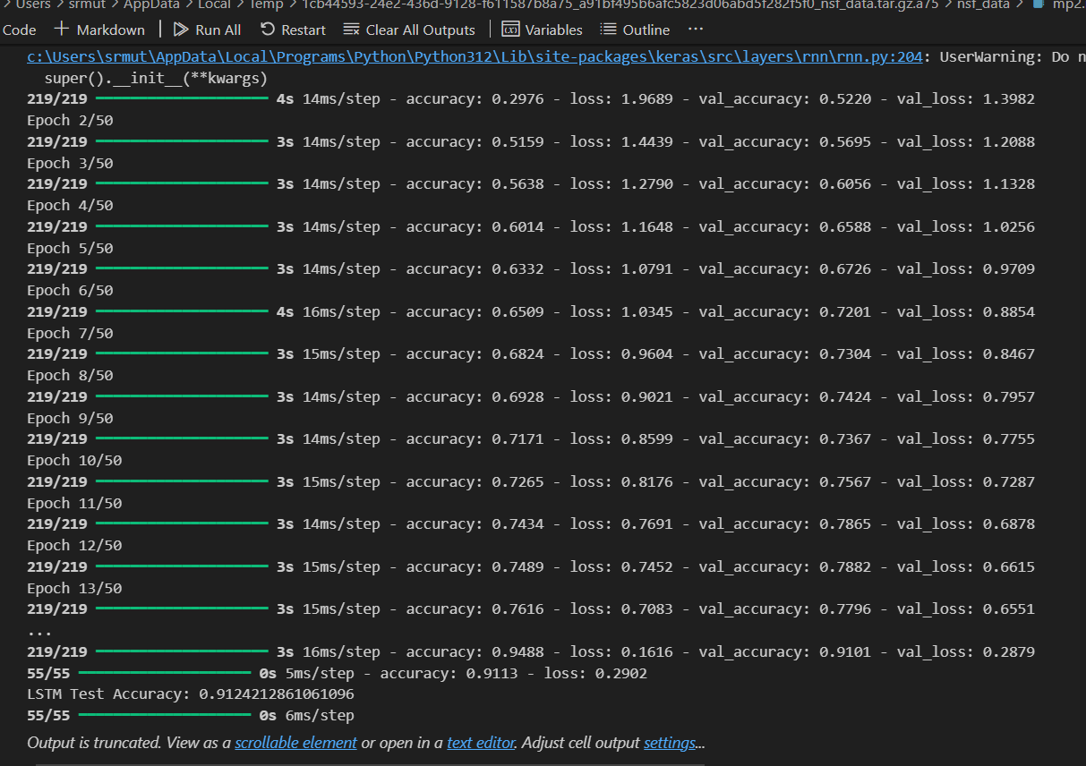
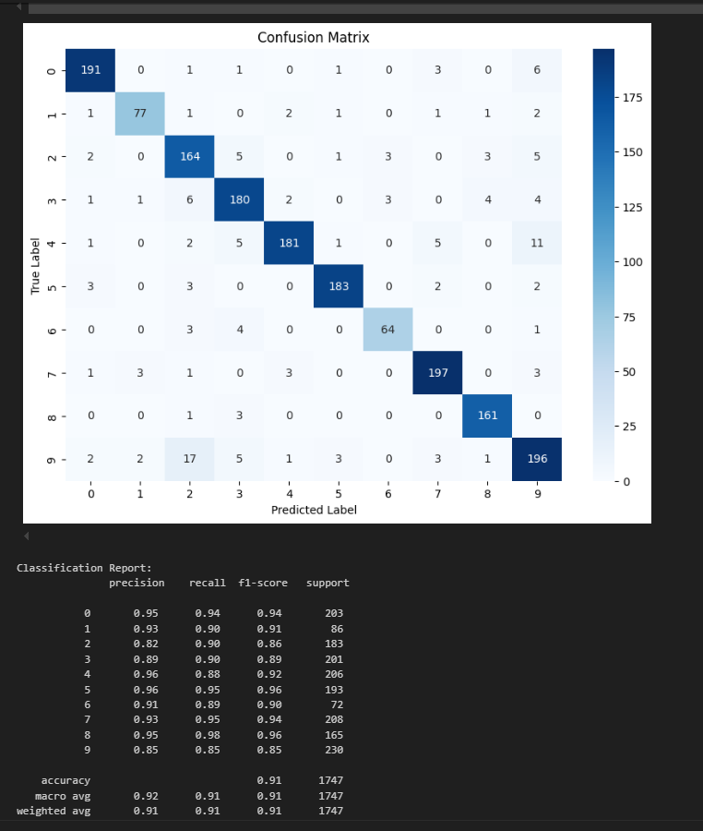
LSTM:
Accuracy:
Confusion Matrix:

Slide 18
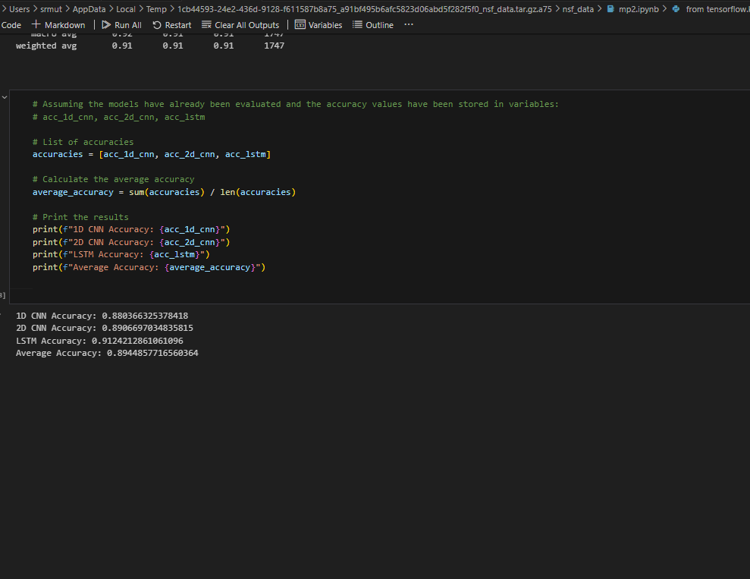
AVERAGE ACCURACY:

Slide 19

Real-Time Sound Classification:

Slide 20
Tools:
Machine learning development:
Vs code
Python
TensorflowLite
Numpy,pandas,Scikit-learn
Jupyter Notebooks
Mobile app development:
Android studio
Flutter SDK
Dart programming language
Testing and Debugging:
Android emulator

Slide 21

Safety Solution Interface Preview

Slide 22
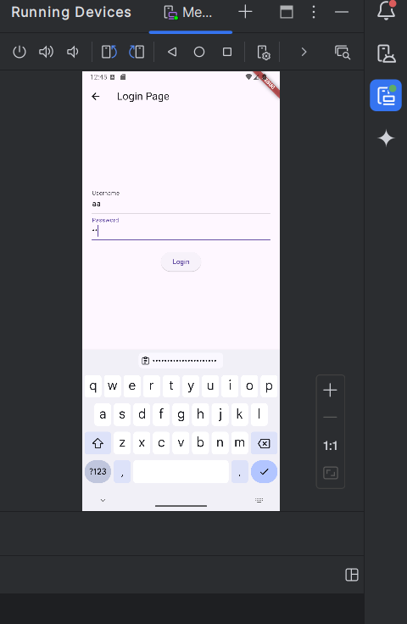
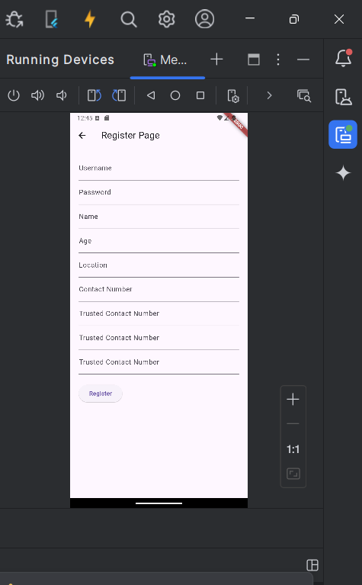
LOGIN &REGISTER:

Slide 23

REFERENCE:
https://www.ijert.org/implementation-of-iot-based-real-time-womens-safety-system-3
https://www.mdpi.com/2079-9292/10/7/850
https://www.mdpi.com/2227-9709/7/3/23
https://www.researchgate.net/publication/326212440_Urban_noise_recognition_with_convolutional_neural_network
https://www.researchgate.net/publication/353073417_Sentiment_analysis_in_non-fixed_length_audios_using_a_Fully_Convolutional_Neural_Network
https://www.sciencedirect.com/science/article/pii/S2352146522001648
https://www.researchgate.net/publication/351429605_Sound_Classification_Based_on_Multihead_Attention_and_Support_Vector_Machine
https://www.sciencedirect.com/science/article/abs/pii/S1568494623004416

Slide 24
CONCLUSION:
AI-Driven Threat Detection:
The research developed a software-based system that uses NLP and deep learning to identify dangerous situations by analyzing ambient noise, effectively recognizing potential threats.
Automatic Emergency Response:
The system automatically alerts victims' emergency contacts, providing immediate assistance when a threat is detected, enhancing personal safety.
High Accuracy and Effectiveness:
The system demonstrated a strong performance with an average accuracy of 91.00% in classifying audio events, showing its effectiveness in real-world threat identification scenarios.
Notes:
<number>

